Slide 1
Calibration of CASM to
Study 19b toxic effects
SM Bartell
Cardno-Stantec
September 30, 2022

Slide 2
Methods: CASM calibration to reported toxic effects
Previous CASM calibration to 19b control data used as baseline
Initial toxic effects benchmarks derived
  Spreadsheet summary of surrogate and predicted endpoints
  Other reported information
EC50 values systematically adjusted (+/-) for the selected taxa
Perform toxic effects simulations using consensus exposure profile
Toxic effect simulation results compared with reported effects
  Average deviation from baseline
  Maximum deviation from baseline
Plot results

Slide 3
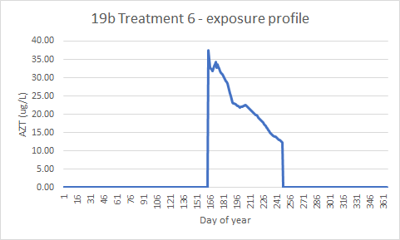
Daily concentrations of AZT used in CASM simulations

Slide 4
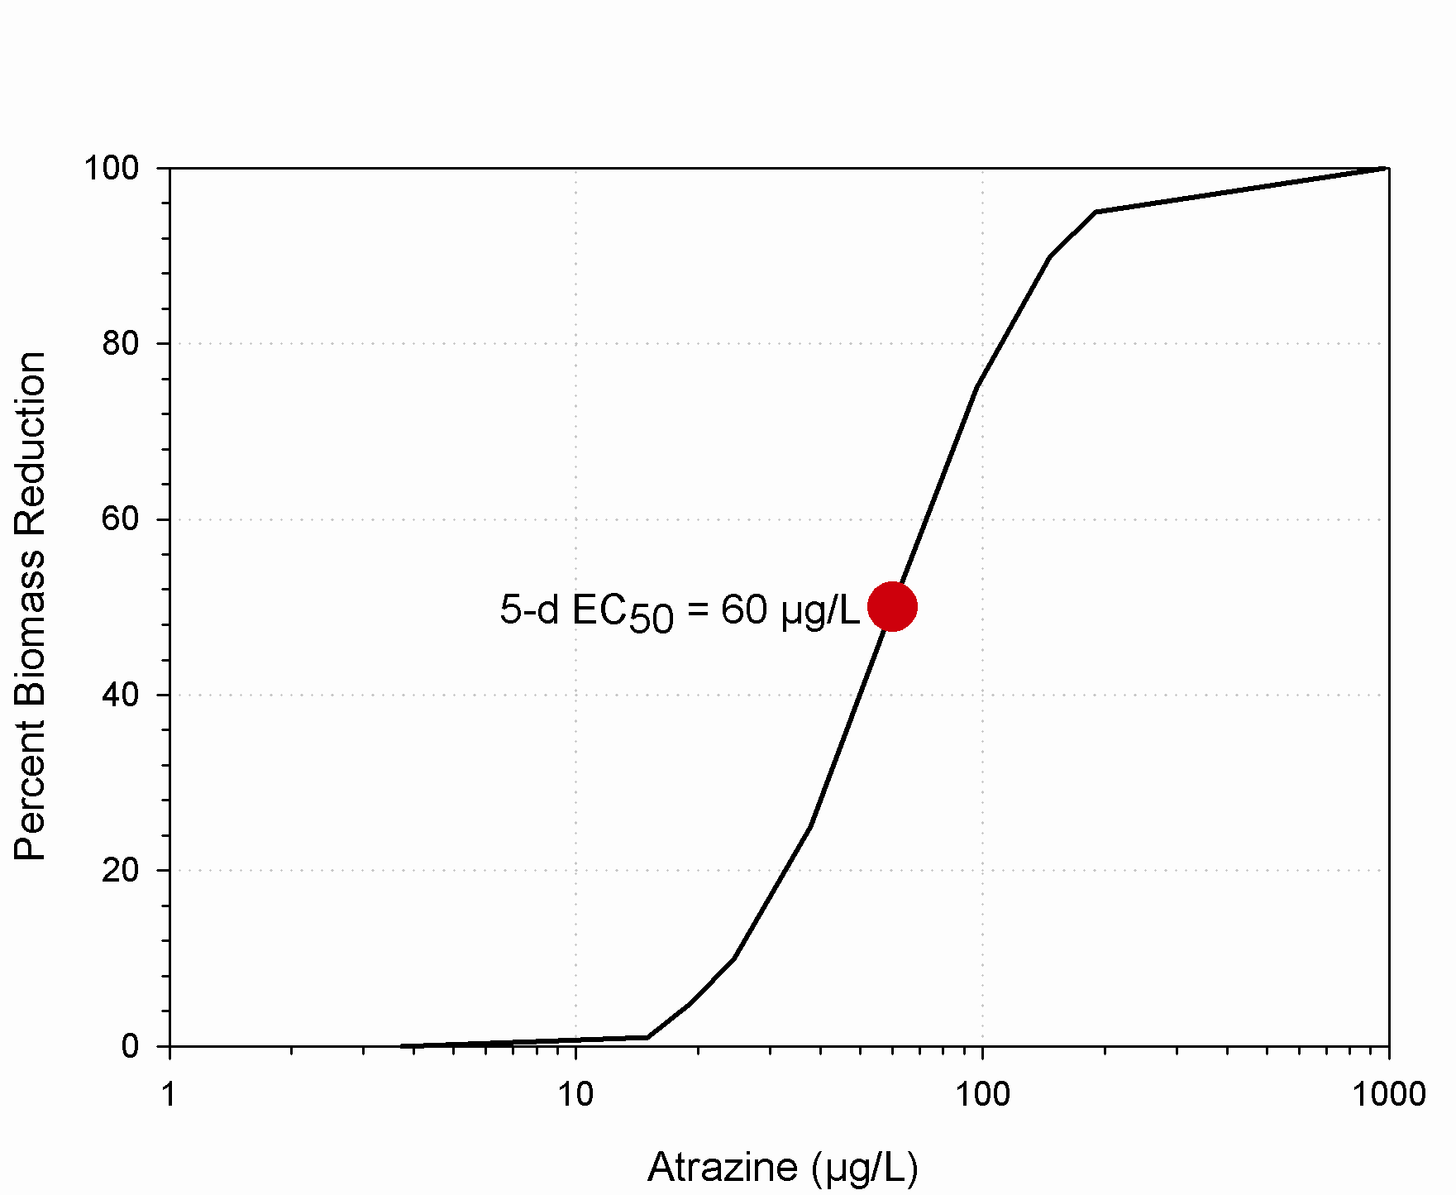
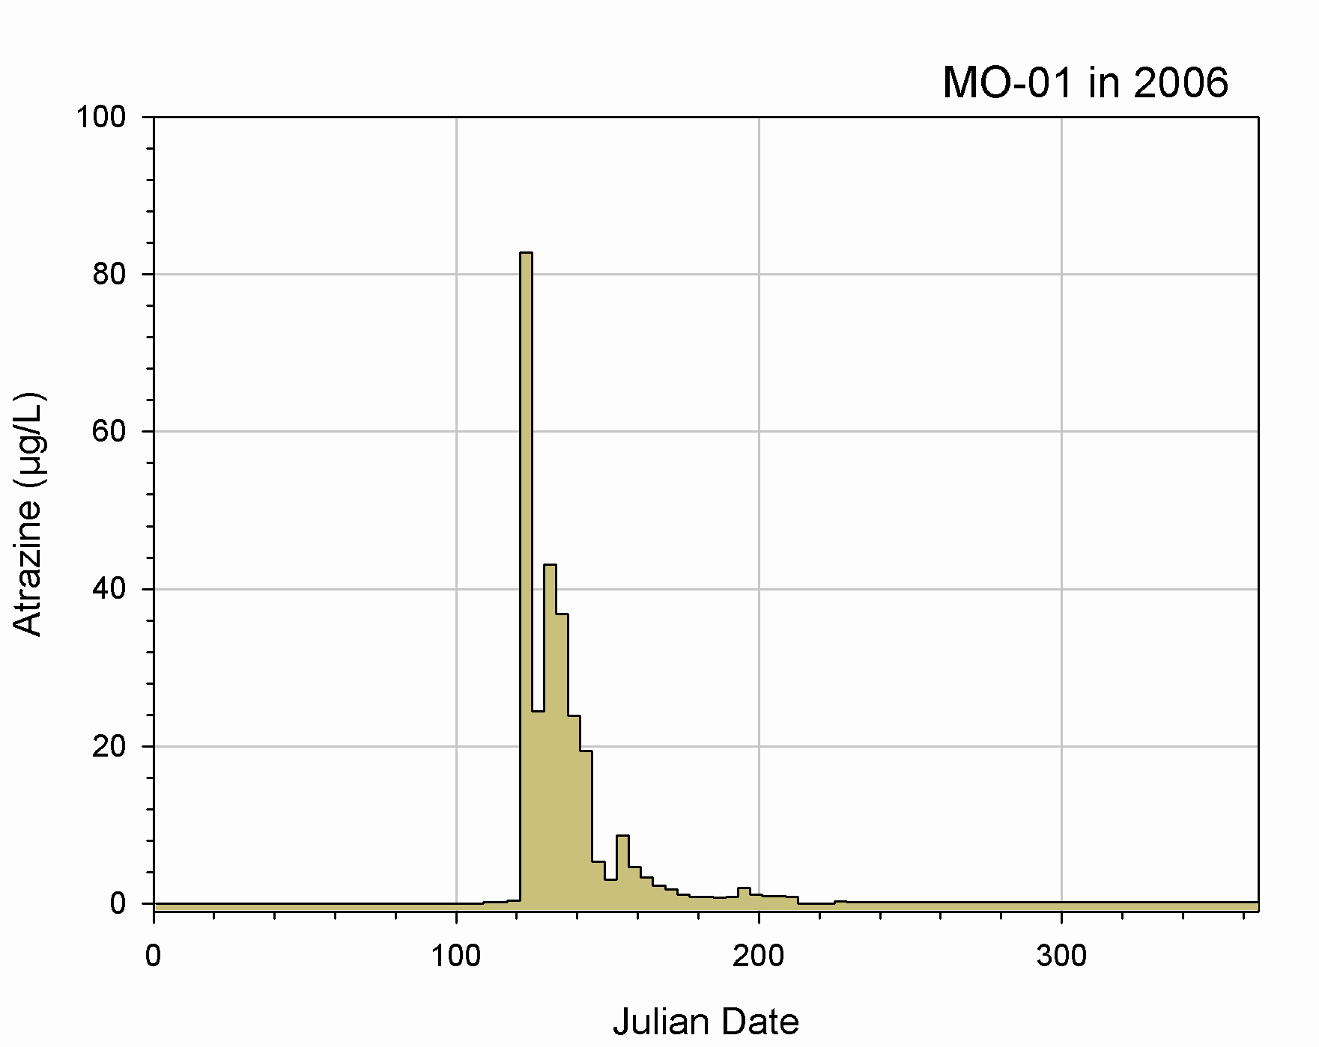
CASM: Translating daily exposure to effects on population growth
Toxic Effects Factors (TEFs)
Calculated daily
Population specific
Reversible effects
EC₅₀ = 60 μg/L
Percent reduction in growth rate
Adjust growth parameters to produce 20% reduction
in daily growth rate: TEF
Exposure: 35 μg/L

Slide 5
Examples of modeled effects on daily periphyton biomass

Slide 9
EC50: 19 ppb

Slide 10
EC50: 57 ppb

Slide 14
Initial toxicity benchmark values
Model population | EC50 (µg/L)
Diatoms - phytoplankton | 14
Cryptophytes - phytoplankton | 9500
Cladocera – small | 102
Copepod – predatory | 130
Rotifer – herb2 | 4000
Nauplii | 100000
Daphnidae | 159
Calibrated toxicity benchmark values
Model population | EC50 (µg/L)
Diatoms - phytoplankton | 146
Cryptophytes - phytoplankton | 128
Cladocera - small | 40
Copepod - predatory | 16
Rotifer – herb2 | 4000
Nauplii | 1
Daphnidae | 19; 57 (revised)

Slide 15
Summary of CASM performance
Population | False negatives | False positives | Average ME
Diatoms - phytoplankton | 3 | 1 | 38
Cryptophytes - phytoplankton | 3 | 1 | 40
Copepods - predatory | 0 | 3 | 36
Nauplii | 0 | 0 | 10
Cladocera - small | 7 | 0 | 83
Daphnidae | 7 | 6 | 66
Daphnidae - revised | 0 | 7 | 59
Rotifers – herb 2 | 10 | 0 | 207

Slide 16
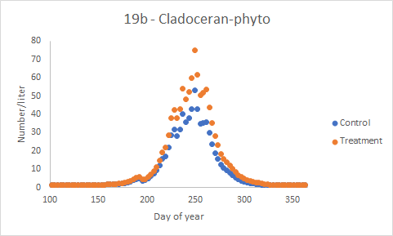
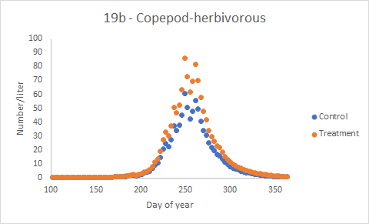
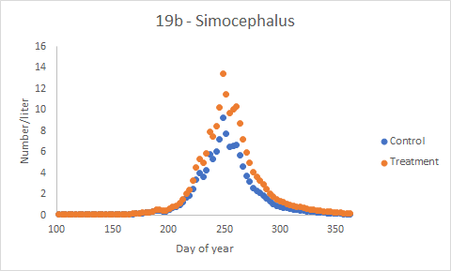
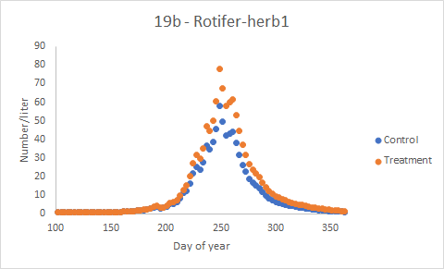
CASM indirect effects - zooplankton

Slide 17
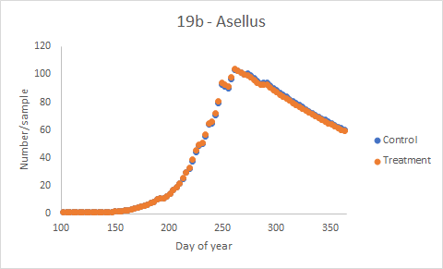
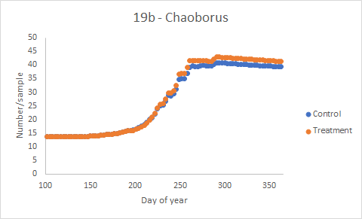
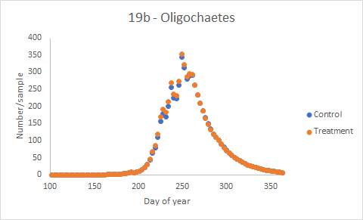
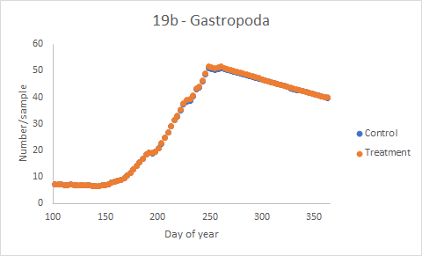
CASM indirect effects - macroinvertebrates

Slide 18
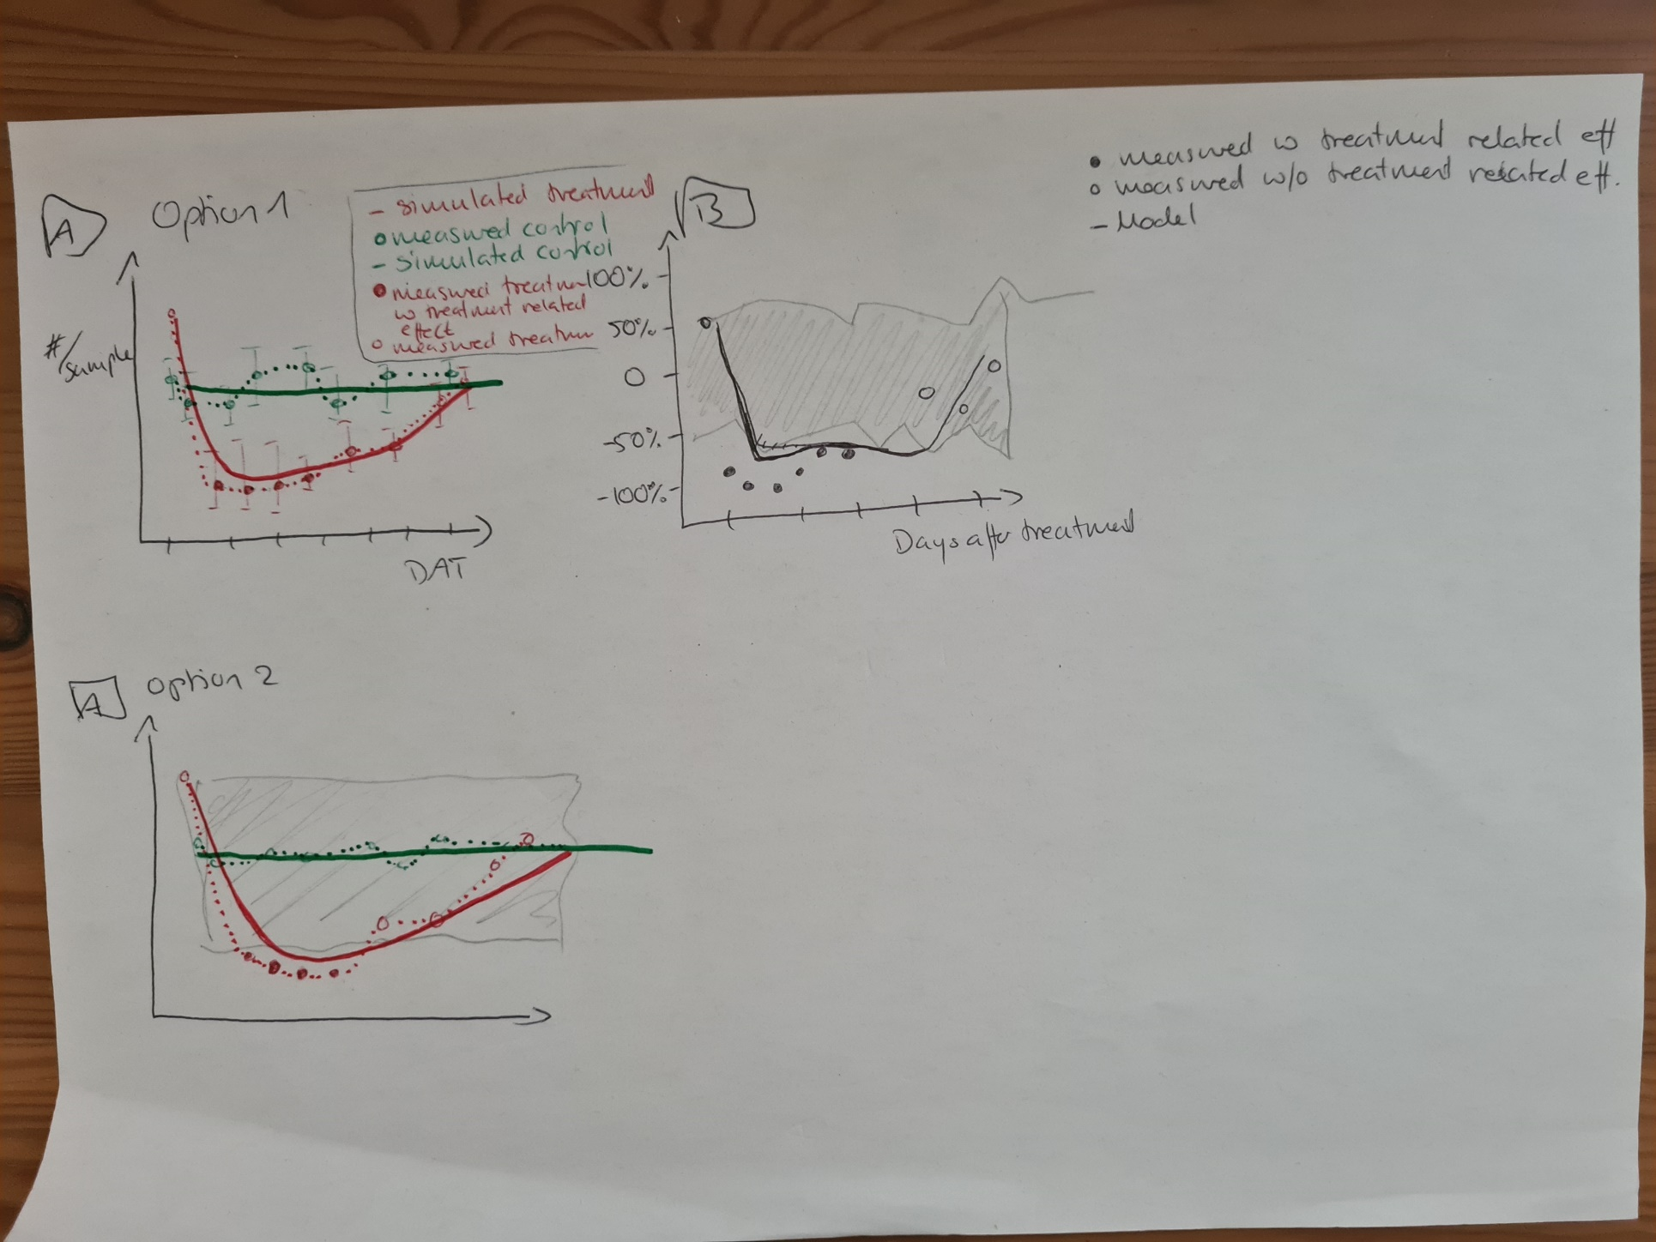
General

Slide 19
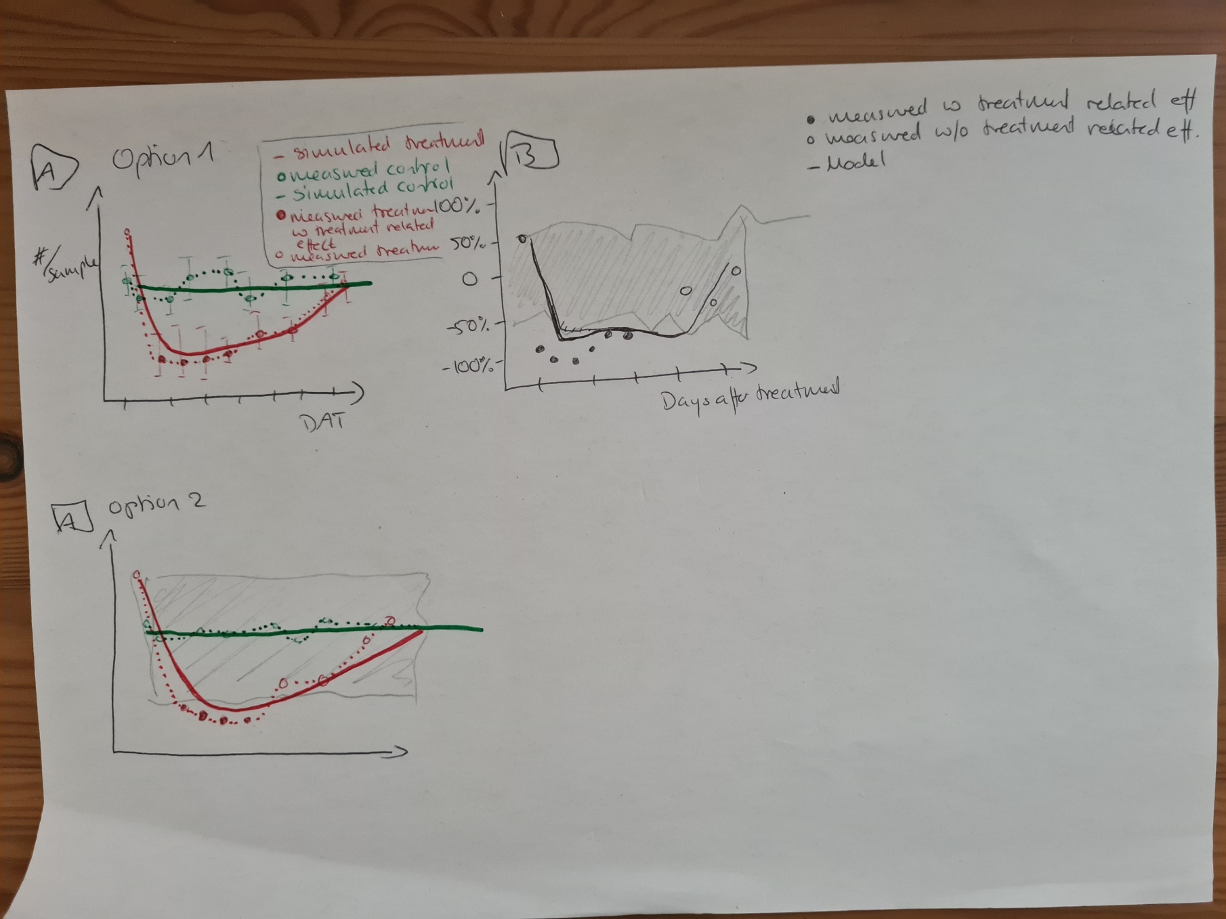
To evaluate: Option for models with multiple outputs

